Slide 1
CSE 707
Distributed Computing Systems
Course Instructor: Annajiat Alim Rasel
Mehnaz Ara Faizul (ST)
Humaion Kabir Mehedi (RA)
Ripa Sarkar
ID: 23366009
Team No: 41

Slide 2
Paper Title
Federated Learning for Breast Density Classification: A Real-World Implementation
by Holger R. Roth, Ken Chang, Praveer Singh, Nir Neumark, Wenqi Li, Vikash Gupta, Sharut Gupta, Liangqiong Qu, Alvin Ihsani, Bernardo C. Bizzo, Yuhong Wen, Varun Buch, Meesam Shah, Felipe Kitamura, Matheus Mendonça, Vitor Lavor, Ahmed Harouni, Colin Compas, Jesse Tetreault, Prerna Dogra, Yan Cheng, Selnur Erdal, Richard White, Behrooz Hashemian, Thomas Schultz, Miao Zhang, Adam McCarthy, B. Min Yun, Elshaimaa Sharaf, Katharina V. Hoebel, Jay B. Patel, Bryan Chen, Sean Ko, Evan Leibovitz, Etta D. Pisano, Laura Coombs, Daguang Xu, Keith J. Dreyer, Ittai Dayan, Ram C. Naidu, Mona Flores, Daniel Rubin, Jayashree Kalpathy-Cramer

Slide 3
Abstract
Objective: Investigate the use of Federated Learning (FL) for collaborative medical imaging model training.
Setting: Seven international clinical institutions collaborated on breast density classification using BI-RADS.
Findings:
Successful model training in a decentralized, non-centralized data-sharing environment.
FL models outperform local models by 6.3% on average.
Models exhibit a 45.8% relative improvement in generalizability across diverse datasets.

Slide 4
Introduction
Advancements in Medical Image Analysis
Dominance of Deep Learning: Deep learning is pivotal in medical image analysis.
Data Challenges:
DL requires large data sets.
Data sharing poses logistical challenges.
Solution: Federated Learning (FL) as an alternative for collaborative model training.

Slide 5
Related Works
Breast Density Scoring
Importance of Breast Density:
Estimation of cancer risk.
Impact on screening sensitivity.
BI-RADS Criteria:
Four classes based on mammography.
Challenges:
Inter-rater variability.
Subjectivity in BI-RADS criteria.
DL Applications: DL shows promise in breast density classification.

Slide 6
Federated Learning
Revolutionizing Digital Health
Instrumentality of FL: Vital for digital health's future.
FL Process:
Decentralized training.
Model parameter sharing, not raw data.
Applicability to Medical Imaging: FL's potential in medical imaging tasks.
Security and Privacy: Discussed for FL in medical imaging.

Slide 7
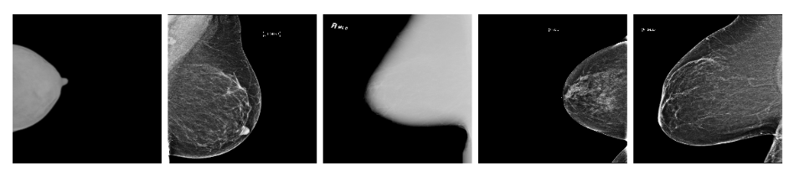
Federated Learning
Figure 1: Mammography data examples from different sites.

Slide 8
Method

Slide 9
Real-World Implementation
FL Approach:
Seven international clients.
Mammography data retrospective selection after IRB approval.
Dataset Characteristics:
Non-IID data distribution.
Varied intensity distributions among sites.
Client-Server-Based FL:
FederatedAveraging algorithm.
Model parameters sharing and aggregation.

Slide 10
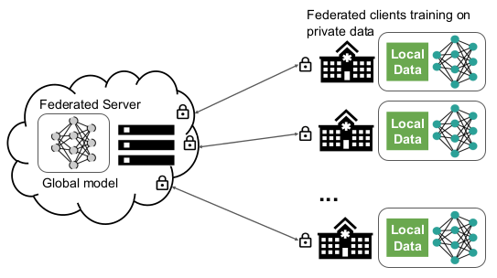
Figure 2: Federated learning in medical imaging.

Slide 11
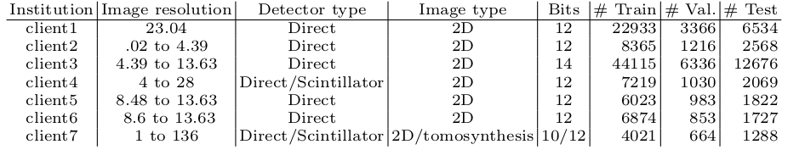
Table 1: Dataset characteristics at each client.

Slide 12
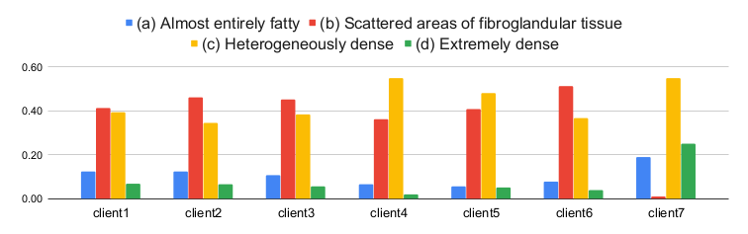
Figure 3: Class distribution at different client sites as a fraction of their total data.

Slide 13
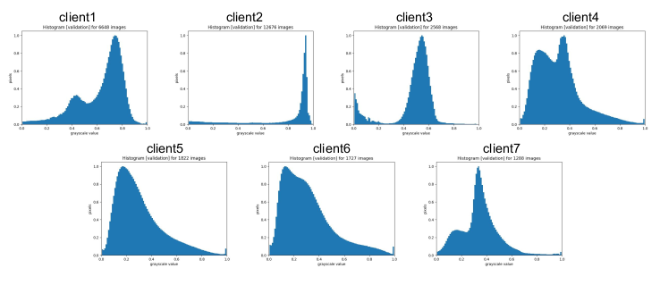
Figure 4: Intensity distribution at different sites.

Slide 14
Classification Model & Implementation
Model Details:
DenseNet-121 for breast density classification.
Four BI-RADS categories.
Data Processing:
Normalization and resampling.
Patient-level prediction.
Training Details:
FL training for 300 rounds.
Local fine-tuning after FL.

Slide 15
Evaluation Metric
Kappa Score:
Cohen’s linear weighted kappa used.
Evaluation against radiologists' ground truth.
Performance Metrics:
Locally best models compared before and after FL.
Interpretation of kappa scores.

Slide 16
Results
Performance Comparison:
Locally best models' performance before and after FL.
6.3% relative improvement on average.
45.8% improvement in generalizability.

Slide 17
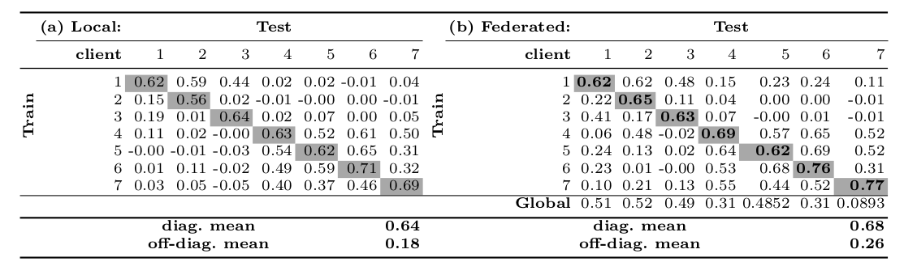
Results
Table 2: (a) local training data alone and (b) after federated learning

Slide 18
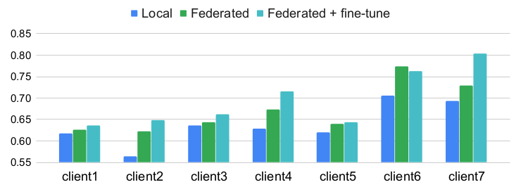
Results
Figure 5: kappa performance

Slide 19
Discussion & Conclusions
Key Findings:
FL achieves more accurate and generalizable models.
Comparable performance to centralized datasets reported in the literature.
Challenges and Future Work:
Data harmonization, domain adaptation, and addressing class imbalance.
Incorporating privacy-preservation techniques.

Slide 20
References
[1] Baweja, C., Glocker, B., Kamnitsas, K.: Towards continual learning in medical imaging. arXiv preprint arXiv:1811.02496 (2018).
[2] Boyd, N., Byng, J., Jong, R., Fishell, E., Little, L., Miller, A., Lockwood, G., Tritchler, D., Yaffe, M.J.: Quantitative classification of mammographic densities and breast cancer risk: results from the canadian national breast screening study. JNCI: Journal of the National Cancer Institute 87(9), 670–675 (1995).
[3] Boyd, N.F., Guo, H., Martin, L.J., Sun, L., Stone, J., Fishell, E., Jong, R.A., Hislop, G., Chiarelli, A., Minkin, S., et al.: Mammographic density and the risk and detection of breast cancer. New England journal of medicine 356(3), 227–236 (2007).
[4] Chang, K., Balachandar, N., Lam, C., Yi, D., Brown, J., Beers, A., Rosen, B., Rubin, D.L., Kalpathy-Cramer, J.: Distributed deep learning networks among institutions for medical imaging. Journal of the American Medical Informatics Association 25(8), 945–954 (2018).
[5] Dunnmon, J.A., Yi, D., Langlotz, C.P., Ré, C., Rubin, D.L., Lungren, M.P.: Assessment of convolutional neural networks for automated classification of chest radiographs. Radiology 290(2), 537–544 (2019).

Slide 21
THANK YOU

